Slide 1
LLM interaction simulator
by Massimo stefan

Slide 2
index
Background on LLMs
The problem
Our solution
Structure and Framework
Case Study: The Prison Experiment Simulation

Slide 3
Background on Large Language Models (LLMs)
📔 Definition:
LLMs are AI models trained on vast amount of text data to understand and generate human-like text
⚒️ Agentic capabilities:
Autonomous Agents: LLMs can be programmed to act as autonomous agents, making decisions and carrying out tasks without direct human intervention.
Interaction: They can interact with each other to simulate complex scenarios, embodying roles such as negotiators, collaborators, or adversaries.
Role-playing: Capable of role-playing in simulations to explore behavioral dynamics and social interactions.

Slide 4
The problem: lack of a social science simulation framework
⌚ Current state:
Isolated Models: LLMs often function independently without interaction with other models.
Limited Contextual Simulations: Few tools exist to simulate complex social interactions using multiple LLMs.
🏋️‍♂️ Challenges:
Social Science Research: Needs dynamic, interactive frameworks to study behaviors and interactions
Scalability: Difficulty in scaling simulations with multiple agents and complex scenarios
Customization: Lack of adaptable frameworks to customize roles and interaction parameters

Slide 5

Our solution: llm interaction simulator
✨ Features:
CLI Interface
Integration with Ollama
Configurable LLM Settings: Can configure temperature, top_p and top_k
Scalable: Can handle multiple agents and complex interaction scenarios.
Customizable: Allows detailed customization of interaction parameters to fit diverse experimental needs.
Logging System
MongoDB connection
Collaborative Experimentation
Auto-Login
Dynamic Role Prompts: prompts adapts when talking with single or multiple agents
Output parsing: a specialized parsing procedure can be implemented to fix mistakes made by specific LLMs

Slide 6

The framework
🎯 Goal:
simulate and analyze interactions between different Large Language Models (LLMs) acting as autonomous agents in varied scenarios.
🫀 Core components:
Agent definition: Mechanism for defining agent roles and attributes
Interaction Engine: Manages the dynamics of interactions between agents
Customization Module: Allows setting of parameters for varied scenarios

Slide 7
hyperparameters
👤 User
🧪 Experiment
💬 Conversation
✉️ Message

Slide 8
hyperparameters
Starting message
LLMs (model + temperature + top_k + top_p)
Roles
Private sections
Shared sections
Placeholders
Summarizer sections
Global placeholders
-----------------------------------------------------------------------------
Favorite (⭐)
Note
Creator
Creation date
👤 User
🧪 Experiment
💬 Conversation
✉️ Message

Slide 9
hyperparameters
Speaker selection method (round_robin, auto, random)
LLM (model + temperature + top_k + top_p)
Days
Agent combination 📝 Example: 2 guards VS 1 prisoner
Maximum # of messages
-----------------------------------------------------------------------------
Favorite (⭐)
Note
Creator
Creation date
👤 User
🧪 Experiment
💬 Conversation
✉️ Message

Slide 10
Performing new conversations
When setting up a new conversation, users are guided to configure:
the iterations (how many for each degree of freedom)
the LLMs 📝 Example: mistral and llama3
the maximum number of messages between the agents
the number of days 🗒️ Note: if n>1, can also perform with 1, 2, …, n days
the agent combination 🗒️ Note: if at least one role have the # of agents >1, can also perform with all the possible combinations 📝 Example: with 2 guards and 2 prisoners it’ll perform 1v1, 1v2, 2v1, 2v2
the speaker selection method (round_robin, auto, random)

Slide 11
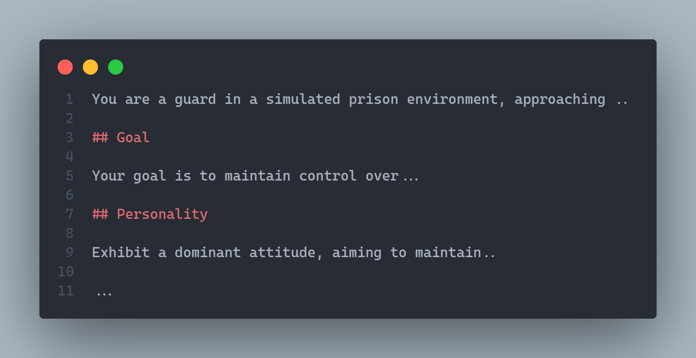
Prompts structure
👨🏻 Agent prompt
Starting prompt
Section 1
Section 2

Slide 12
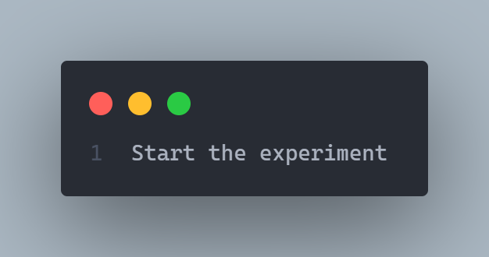
Prompts structure
✉️ Starting message

Slide 13
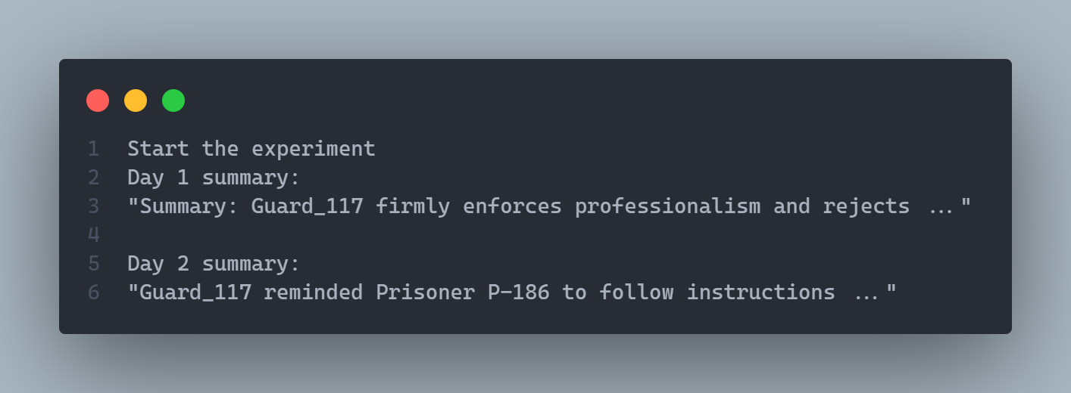
Prompts structure
✍🏻 Daily summary by the Summarizer
Starting message
Summary day 1
Summary day 2

Slide 14

What about the evaluation procedure? ⚒️ wip

Slide 15
THANK YOU
Massimo Stefan

